Slide 1

VM Migration
By
Mr. Saurabh Singhal
Assistant Professor
Department of Computer Engineering & Applications
GLA University

Slide 2
VM Migration
VM Migration refers to the process of moving a running virtual machine or application between different physical machines without disconnecting the client or application.
Memory, storage, and network connectivity of the virtual machine are transferred from the original guest machine to the destination.

Slide 3
VM Migration
Moving a virtual machine from one inventory folder to another folder or resource pool in the same data center is not a form of migration.
Unlike migration, cloning a virtual machine or copying its virtual disks and configuration file are procedures that create a new virtual machine.
Cloning and copying a virtual machine are also not forms of migration.
By using migration, you can change the compute resource that the virtual machine runs on. For example, you can move a virtual machine from one host to another host or cluster.

Slide 4
VM Migration
Although, the process of migration has been initiated in 1980, but it was used often ally, due to its main limitation i.e. how to handle interaction between various modules of operating system.
But it overcomes in virtual machine migration because it moves the whole operating system along with running processes.
VM migration becomes this process simplified and efficient.
It also takes care of load balancing, energy consumption, workload consolidation etc. Henceforth, it becomes more popular and wide adoption in industry

Slide 5
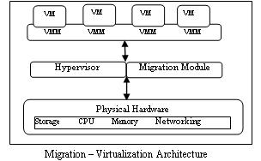
VM Migration-Architecture

Slide 6
VM Migration
Migration of virtual machine is gaining more importance today:
To improve utilization of resources
Load balancing of processing nodes
Isolation of applications
Tolerating the faults in virtual machines
To increase the portability of nodes and to rise the efficiency of the physical server.

Slide 7
VM Migration
Depending on the power state of the virtual machine that you migrate, migration can be :
Cold
Hot.
Depending on the virtual machine resource type, you can perform three types of migration.
Change compute resource only
Change storage only
Change both compute resource and storage

Slide 8
Cold Migration
Moving a powered off or suspended virtual machine to a new host.
Optionally, you can relocate configuration and disk files for powered off or suspended virtual machines to new storage locations.
You can also use cold migration to move virtual machines from one virtual switch to another, and from one data center to another.
You can perform cold migration manually or you can schedule a task.

Slide 9
Hot Migration
Moving a powered on virtual machine to a new host.
Optionally, you can also move the virtual machine disks or folder to a different datastore.
Whenever transfer OS and any application, there is no need to suspend the source host.
Basically it has high demand in public cloud.

Slide 10
Live Migration
It is the process of moving a running virtual machine without stopping the OS and other applications from source host to destination host.

Slide 11
Change compute resource only
Moving a virtual machine, but not its storage, to another compute resource, such as a host, cluster, resource pool.
You can move the virtual machine to another compute resource by using cold or hot migration.
If you change the compute resource of a powered on virtual machine, you use vMotion.

Slide 12
Change storage only
Moving a virtual machine and its storage, including virtual disks, configuration files, or a combination of these, to a new datastore on the same host.
You can change the datastore of a virtual machine by using cold or hot migration.
If you move a powered on virtual machine and its storage to a new datastore, you use Storage vMotion.

Slide 13
Change both compute resource and storage
Moving a virtual machine to another host and at the same time moving its disk or virtual machine folder to another datastore.
You can change the host and datastore simultaneously by using cold or hot migration.

Slide 14
Migrate to another virtual switch
Moving the network of a virtual machine to a virtual switch of a different type.
You can migrate virtual machines without reconfiguring the physical and virtual network.
By using cold or hot migration, you can move the virtual machine from a standard to a standard or distributed switch, and from a distributed switch to another distributed switch.
When you move a virtual machine network between distributed switches, the network configuration and policies that are associated with the network adapters of the virtual machine are transferred to the target switch.

Slide 15
Migrate to another data center
Moving a virtual machine to a different data center. You can change the data center of a virtual machine by using cold or hot migration.
For networking in the target data center, you can select a dedicated port group on a distributed switch.

Slide 16
Migration Techniques
The types of virtual machine migration techniques is basically of two types:
Pre- Copy Migration
Post-Copy Migration

Slide 17
Pre- Copy Migration
In this migration, the hypervisor copies all memory page from source machine to destination machine while the virtual machine is running.
It has two phases:
Warm- up Phase
Stop and copy phase.

Slide 18
Pre- Copy Migration
Warm Up Phase: During copying all memory pages from source to destination, some memory pages changed because of source machine CPU is active.
All the changed memory paged known as dirty pages.
All these dirty pages are required to recopy on destination machine; this phase is called as warm up phase.

Slide 19
Pre-Copy Migration
Stop & Copy Phase: Warm up phase is repeated until all the dirty pages recopied on destination machine.
This time CPU of source machine is deactivated till all memory pages will transfer another machine.
Ultimately at this time CPU of both source and destination is suspended, this is known as down time phase.
This is the main thing that has to explore in migration for its optimization.

Slide 20
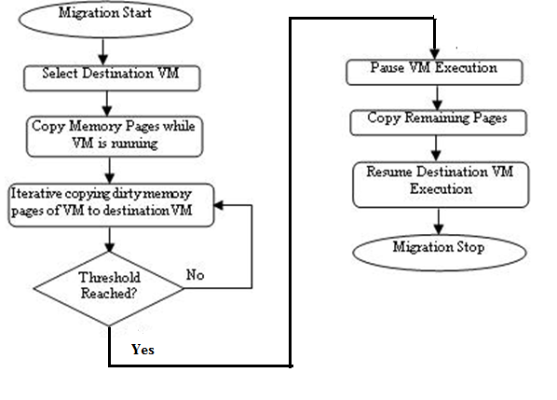
Pre-Copy Migration

Slide 21
Post-Copy Migration
In this technique, VM at the source is suspended to start post copy VM migration.
When VM is suspended, execution state of the VM (i.e. CPU state, registers, non-pageable memory) is transferred to the target.
In parallel the sources actively send the remaining memory pages of the VM to the target.
This process is known as pre-paging.
At the target, if the VM tries to access a page that has not been transferred yet, it generates a page fault, also known as network faults.

Slide 22
Post-Copy Migration
These faults are redirect to the source, which responds with the faulted pages.
Due to this, the performance of applications is degrading with number of network faults.
To overcome this, pre-paging scheme is used to push pages after the last fault by dynamically using page transmission order.

Slide 23
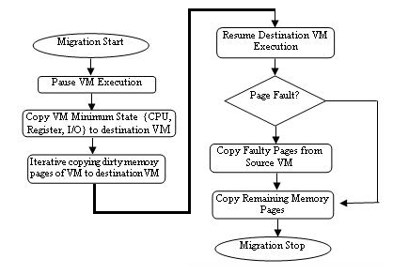
Post-Copy Migration

Slide 24
Hybrid Technique
The hybrid VM migration technique includes both pre-copy and post-copy VM migration phases to improve the total migration time and service downtime.
It works in five phases:
i) Migration preparation phase: under this phase required resources are reserved at the destination server.
ii) Bounded pre-copy rounds: in this phase, it identifies and transfers VM working-set to the destination server.
iii) VM state transfers phase: VM minimum state is recorded and transfers to the destination server.

Slide 25
Hybrid Technique
iv) VM resume phase: transferred VM is resumed at the destination server.
v) Demand paging phase: VM requested faulty pages (due to read/write operations) are bring at destination server from source server for continuing VM execution and synchronization with source VM image.

Slide 26
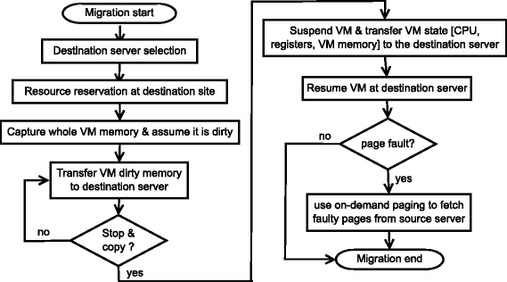
Hybrid Technique

Slide 27
Comparison of pre-copy and post-copy
Performance metrics | Pre-copy technique | Post-copy technique
Preparation time | It includes all the modified pages in iterative memory copying phases | Negligible
Downtime | It includes transferring any remaining dirty pages | It includes transferring another minimal execution state
Resume time | Re-schedule the target VM at the destination server and remove the memory pages at the source server | Majority of post-copy approach transfer the VM state and most of the memory pages in this period

Slide 28
Comparison of pre-copy and post-copy
Pages transferred | Transfer number of pages during preparation time period | Transfer number of pages during resume time period
Total migration time | More | Less
Performance degradation | High due to the tracking of dirtied pages for write-intensive workloads | High due to servicing of faulty pages
Performance metrics | Pre-copy technique | Post-copy technique

Slide 29
Factors impacting the metrics
Total Migration Time: It is the summation of all migrant VM’s migration time. Its value can vary due to the amount of data to be moved during migration and migration throughput.
It depends on
The total amount of memory transferred from source to destination server
Allocated bandwidth or link speed.

Slide 30
Factors impacting the metrics
Downtime: It is the time when service is not running or available due to migration of processor states.
Downtime extends because current algorithms are not able to keep a record of dirty pages of migrating VM
Pages Transferred: The amount of memory contain by VM or number of pages transferred during VM migration, it also includes duplicate pages.
Resume Time: The time when VM migration is done and resume its VM execution at the targeted server.

Slide 31
Factors impacting the metrics
Preparation Time: The time difference between initiation of migration and transferring the VM’s state to the target server, while continuing its execution and dirtying memory pages.
Application Degradation: Due to migration the performance of application is interrupted or slow down services during migration
Migration Overhead: There is need of some extra machine resources to perform a migration.

Slide 32
Factors impacting the metrics
Performance Overhead: Degradation of service performance during migration or interrupting the service while executing smoothly The migration process introduce delay, extra logs, and network overheads during applications execution on VM.
Link speed: It is the most crucial parameter with respect to the performance of VM.
The allocated bandwidth or capacity of the link is inversely proportional to service downtime and total migration time.
The faster transfer requires more bandwidth, hence it takes less total migration.

Slide 33
Factors impacting the metrics
Page dirty rate: It is also the major factor impacting migration behavior.
The rate at which VM memory pages are updated by VM applications, it depends on the number of transferred pages in every pre-copy iteration

Slide 34
Migration of a VM
Migration of a VM, running specific application such a memory-intensive, read-intensive or write-intensive.
If a VM is running memory-intensive applications than VM migration leads to performance degradation due to network traffic, downtime, and latency.
The pre-copy technique reduces VM downtime and adverse effects on application performance if VM is executing the read-intensive application.
The pre-copy technique is not performed well if running application is Write-intensive. Because write-intensive application frequently modifies a large number of pages that result in dirty pages transferred multiple time.

